Slide 1
College, Career & Life Readiness
Kerlie Leonce, CCLR District Specialist

Slide 2
BCPS Vision

Slide 3
Are Students Prepared to Succeed If…
They don’t know what they want to be?
They don’t know how to achieve their goals?
They don’t have resources and support?

Slide 4
BCPS CCLR Strategic Goal The 4 E's

Slide 5
Vision
Build a robust college & career going culture, in which more students enroll and complete post-secondary education
1
Use data to inform and measure success
2
Make students part of the "army" that builds the college & career going culture
3

Slide 6
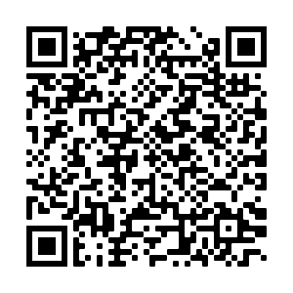
Naviance Middle School Scope & Sequence

Slide 7
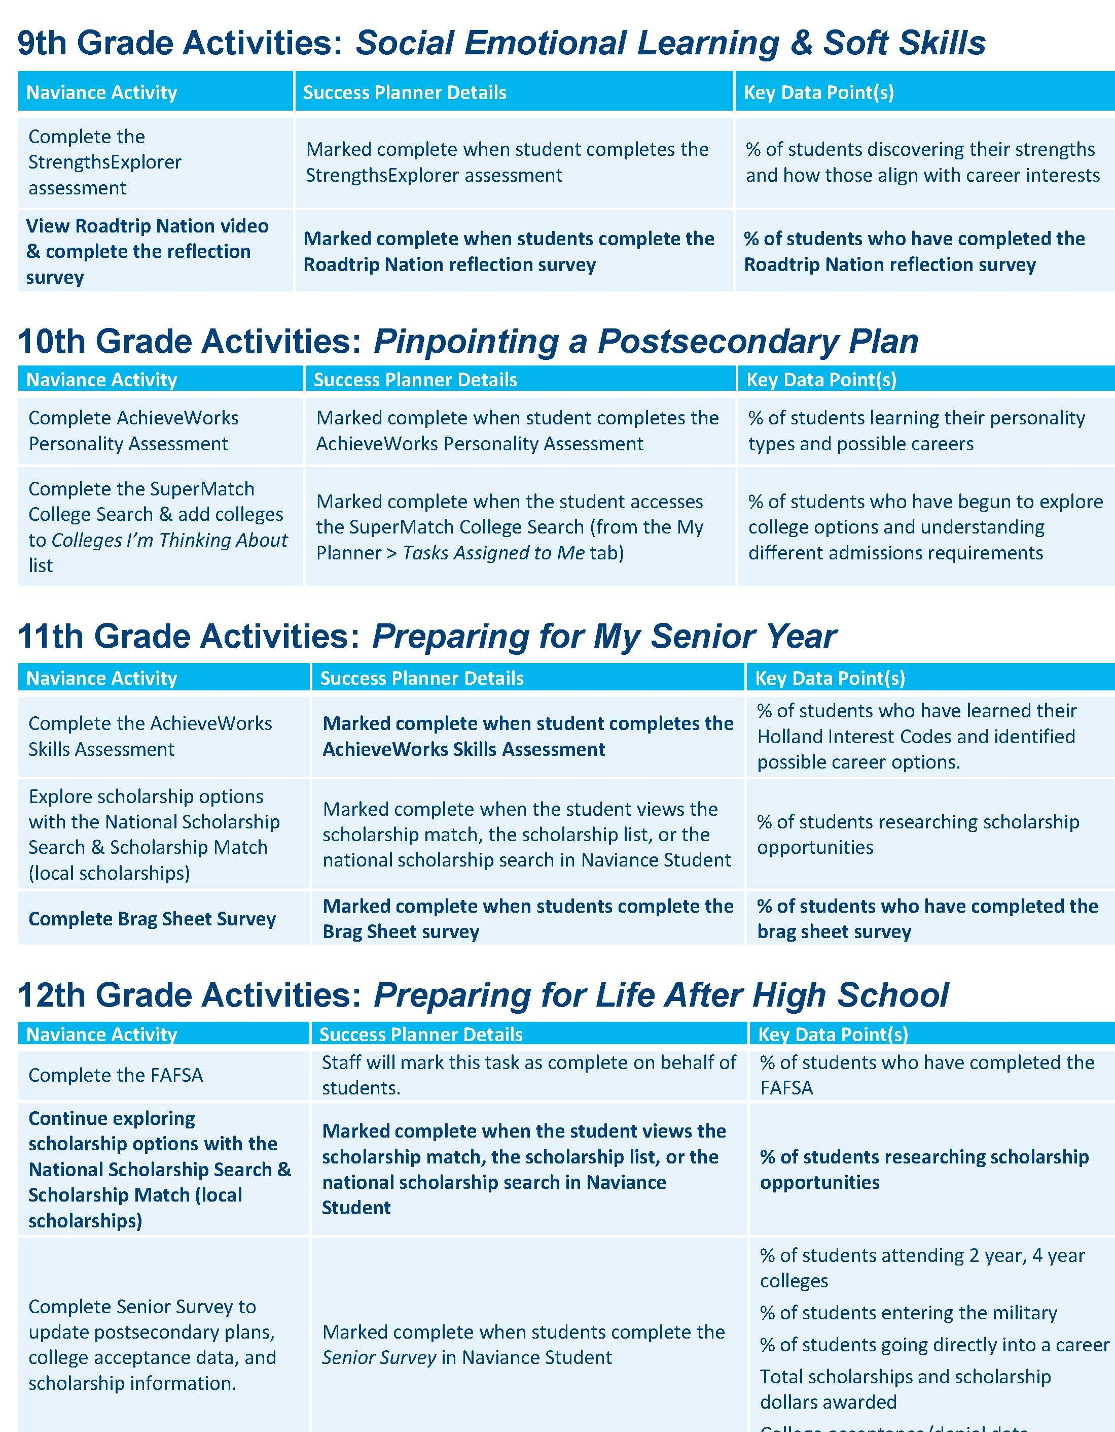
Naviance High School Scope & Sequence

Slide 9
Enroll: Big Topics
Dual Enrollment
An accelerated program that allows eligible students to take postsecondary coursework, simultaneously earning high school and college credits; saving time and money!
A form of dual enrollment, allows eligible high school seniors to enroll in at least 12 credits per term (Fall & Spring); taking all class at the college
Early Admissions
Dual Enrollment courses are for actual college credits, if a student does poorly on these courses, it will reflect on their college transcripts

Slide 10
Testing
PSAT
SAT/ACT
Spring of 11th Grade
Practice Tests
Khan Academy (via CollegeBoard), Public Library
Try & try again! Some colleges superscore results!
Fee Waivers
Eligible students may receive waivers for the SAT, ACT, & college applications; eligibility is based on need.
Parents need to complete both the Meal Benefits Disclosure form & the Household Income Survey (MySchoolApps.com). Then reach out to their BRACE Advisor for waivers.
Students attending a CEP school still need to complete the Household Income Survey

Slide 11
Choosing a College
Paying for College
Florida State University System (SUS)
Community Colleges
Technical Colleges
Sheridan, McFatter, Atlantic
Historically Black Colleges & Universities (HBCU)
Hispanic Serving Institutions (HIS)
Use SuperMatch to help you decide!
Free Application for Federal Student Aid (FAFSA)
For seniors, opens October 1st
Grants
Scholarships (Naviance, BigFutures, BEF)
Institutional Aid
Prepaid
Loans

Slide 12
Bright Futures Scholarships
Florida Academic Scholars (FAS)
Students who meet elibility receive 100% tuition & fees
3.5 GPA, 100 service hours, 29 ACT or 1330 SAT
Florida Medallion Scholars (FMS)
Students who meet elibility receive 75% tuition & fees
3.0 GPA, 75 service hours, 25 ACT or 1210 SAT
Gold Seal Vocational Scholars
Earn 3 full credits in a single Career and Technical Education program, 3.5 in career education courses, 30 service hours, test score requirement on ACT, SAT, or P.E.R.T.
Gold Seal Cape Scholars
Earn a minimum of 5 postsecondary credit hours through CAPE industry certifications that articulate college credit, 30 service hours, enrolled in a career education/certification program

Slide 13
Enlist
Enlisting in the U.S. Military is another great option for students after high school graduation. Service in the armed forces can lead to a job or college-level education.
Joining the military doesn’t mean students can only be a soldier; each branch has many training programs. There are opportunities to become a doctor, engineer, pilot, computer specialist, communications professional and more.
Students must take the Armed Services Vocational Aptitude Battery (ASVAB)
Preparation materials for the ASVAB can be found here: HOME | ASVAB (officialasvab.com)
Local recruiters make visits to schools to provide information and guidance on enlistment

Slide 14
Employ
To increase earning potential, students should consider:
Exploring apprenticeship programs, which provide on-the-job training and education while earning a wage.
Volunteering, to get experience in various fields of interest.
Opportunities:
Career Technical Education Pathways- prepares these learners for the world of work by introducing them to workplace competencies and makes academic content accessible to students by providing it in a hands-on context. Go to browardschools.com/CTACE for more information
Students who meet specified requirements for a comprehensive program of study in career education may be recognized with a Florida Ready to Work Credential or designation reflecting one or more industry certifications
After high school, attending one of our Technical Colleges

Slide 15
Explore
Taking an intentional break via a Gap Year program. A true Gap Year meets the following criteria:
Has a start & end date
Provides experiential learning, to deepen one's practical, professional, and personal awareness
Revolves around volunteering/service, career exploration/experience, &/or is temporary employment that supplements further education
Many Gap Year programs can be paid for through financial aid (FAFSA)
Some colleges offer Gap Year programs prior to starting at the instutuition or for college credits

Slide 16
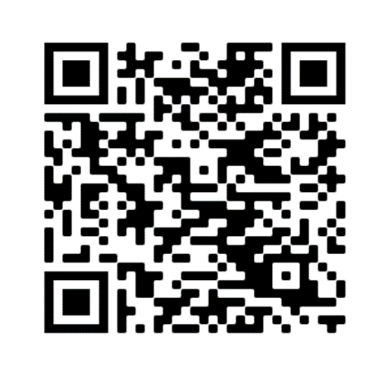
CCLR Resources

Slide 19
Get involved!
School Advisory Council/School Advisory Forum
Parent Teacher Student Organization
Volunteer
Parent/Teacher Conferences
School Counselor or BRACE Appointment

Slide 20
Questions?

